Slide 1
Advanced Image Analysis
2017-2018, 2nd semester
Spatial filtering
Alessandro Bria
Contract Professor
and Post-doc Researcher
email: a.bria@unicas.it

Slide 2
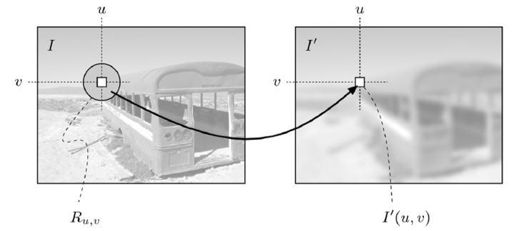
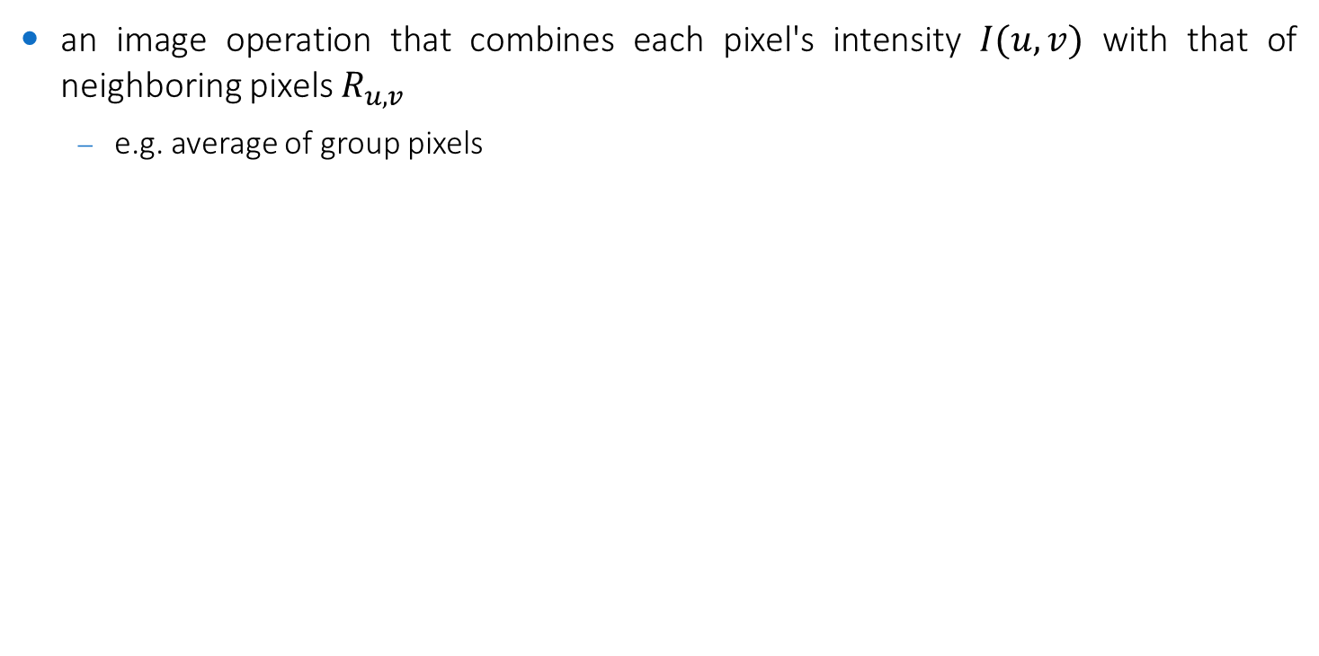
Spatial filtering
an image operation that combines each pixel's intensity $I(u,v)$ with that of neighboring pixels $R_{u,v}$
e.g. average of group pixels

Slide 3
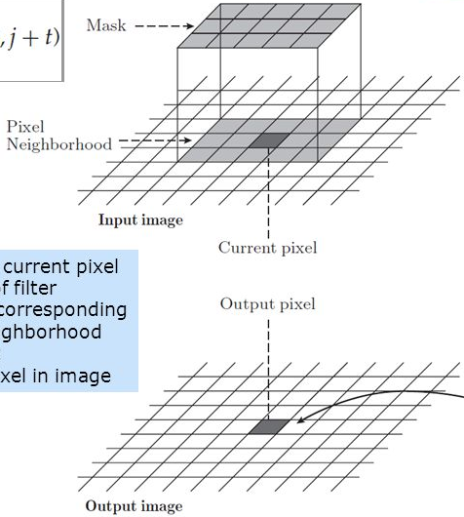
Linear and nonlinear filtering
the transformation rule is often described by a matrix, called filter, with the same size of the considered neighborhood
if the transforming rule is a linear function of the intensities in the considered neighborhood, the technique is called spatial linear filtering
e.g. averaging
otherwise, the technique is called spatial non-linear filtering
e.g. median filtering
Filter

Slide 4
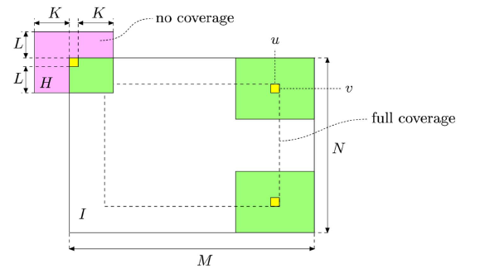
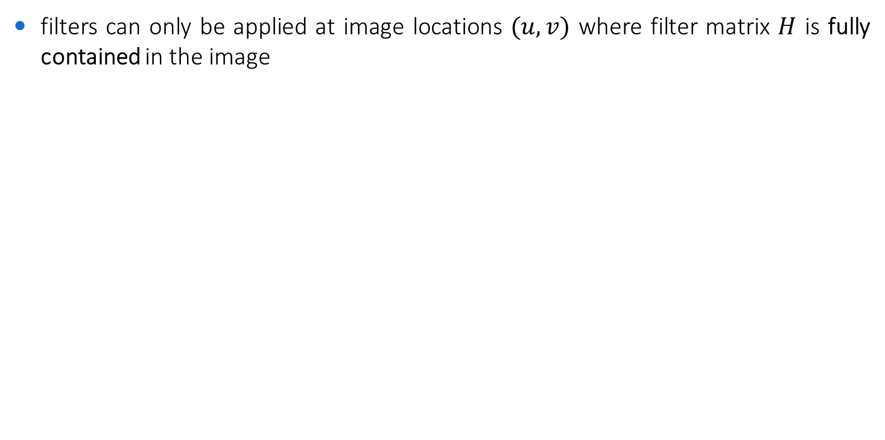
Computation range
filters can only be applied at image locations $(u,v)$ where filter matrix $H$ is fully contained in the image

Slide 5
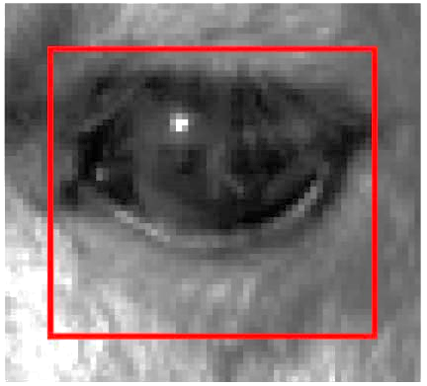
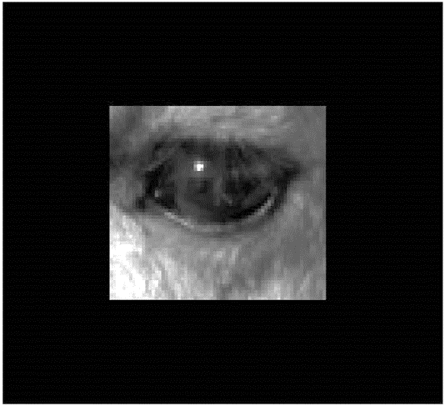
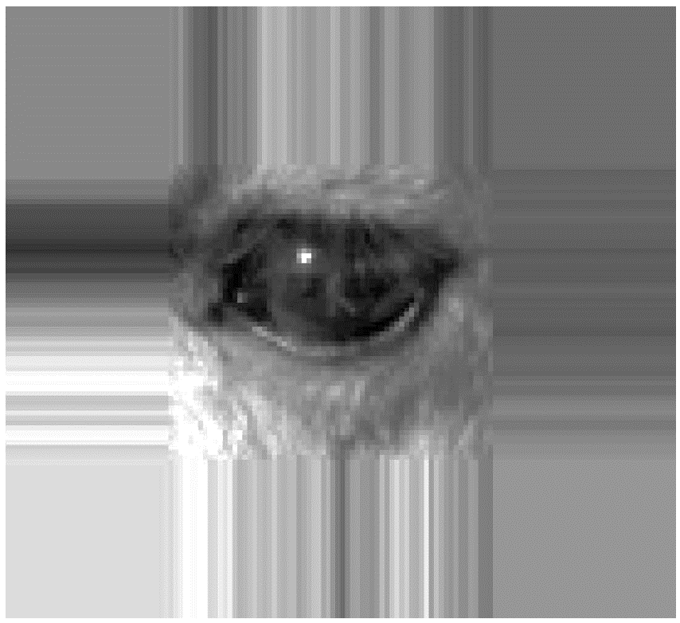
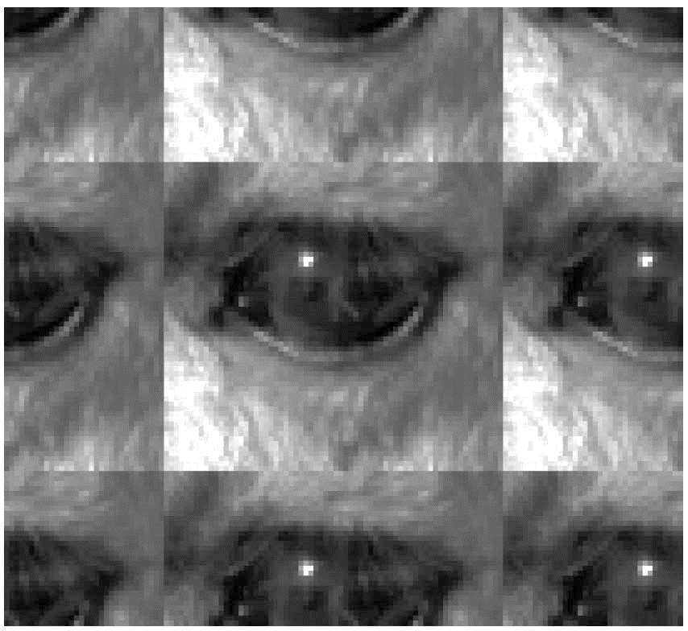
Computation range
what to do at image boundaries?
many different options...the most common are:
crop
pad
extend
mirror

Slide 6
Linear filtering

Slide 7
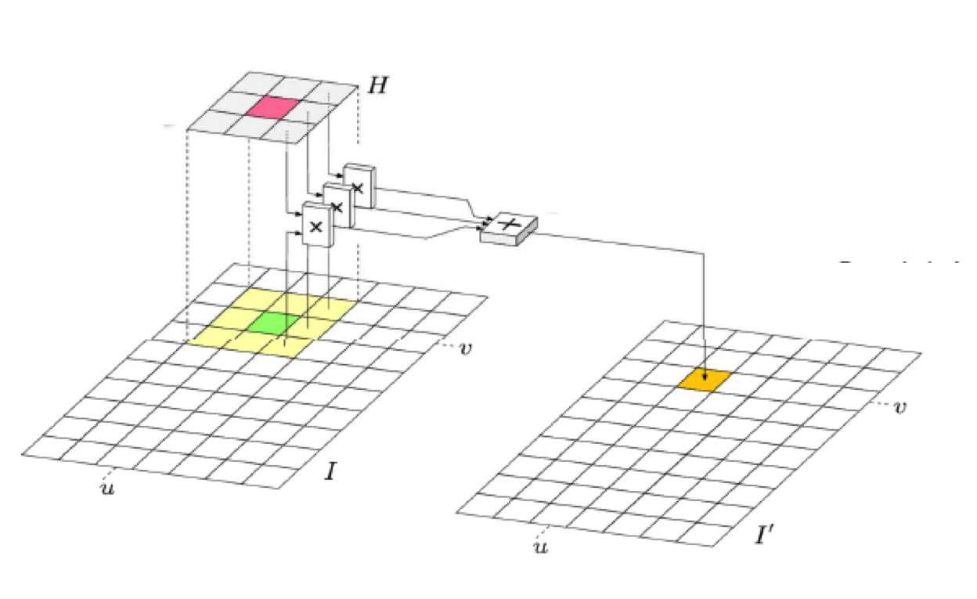
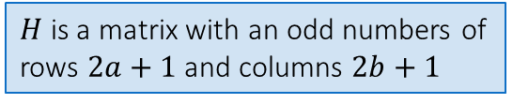
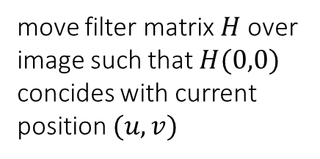
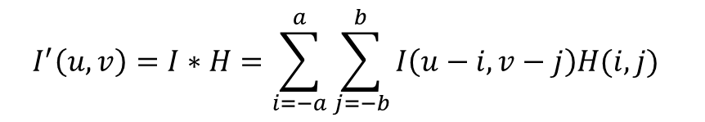
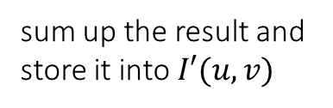
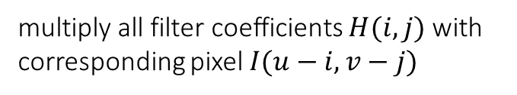
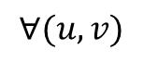
Linear filtering as convolution
$$I^{′}\left(u,v\right)=I∗H=\sum_{i=−a}^{a}{\sum_{j=−b}^{b}{I\left(u−i,v−j\right)H(i,j)} }$$
$H$ is a matrix with an odd numbers of rows $2a+1$ and columns $2b+1$
multiply all filter coefficients $H(i,j)$ with corresponding pixel $I(u−i,v−j)$
$$∀(u,v)$$
move filter matrix $H$ over image such that $H(0,0)$ concides with current position $(u,v)$
sum up the result and store it into $I′(u,v)$

Slide 8
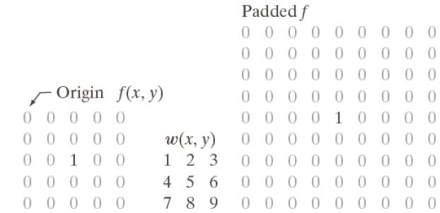
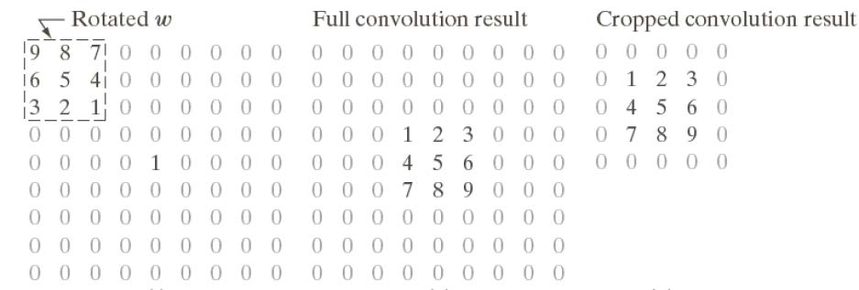
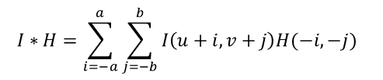
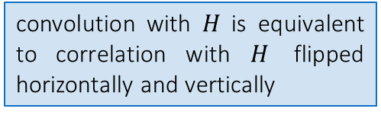
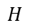

Example
$$H$$
convolution with $H$ is equivalent to correlation with $H$ flipped horizontally and vertically
$$H$$
$$I∗H=\sum_{i=−a}^{a}{\sum_{j=−b}^{b}{I\left(u+i,v+j\right)H(−i,−j)} }$$

Slide 9
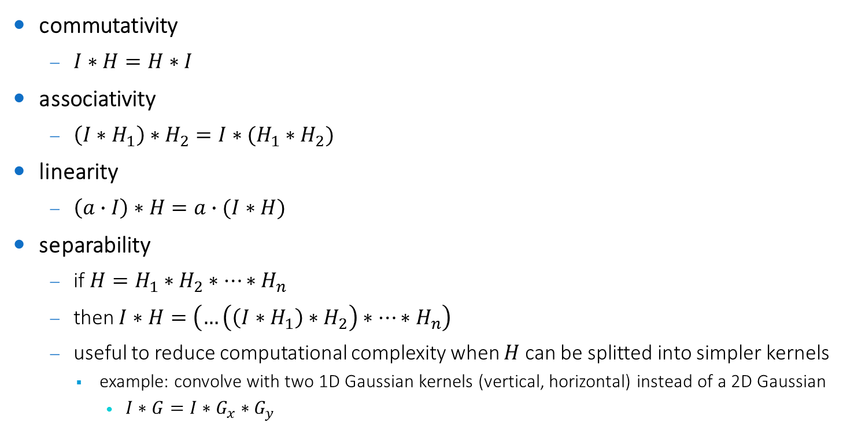
Properties
commutativity
$I∗H=H∗I$
associativity
$\left(I∗H_{1}\right)∗H_{2}=I∗(H_{1}∗H_{2})$
linearity
$\left(a∙I\right)∗H=a∙(I∗H)$
separability
if $H=H_{1}∗H_{2}∗…∗H_{n}$
then $I∗H=\left(…\left(\left(I∗H_{1}\right)∗H_{2}\right)∗…∗H_{n}\right)$
useful to reduce computational complexity when $H$ can be splitted into simpler kernels
example: convolve with two 1D Gaussian kernels (vertical, horizontal) instead of a 2D Gaussian
$I∗G=I∗G_{x}∗G_{y}$

Slide 10
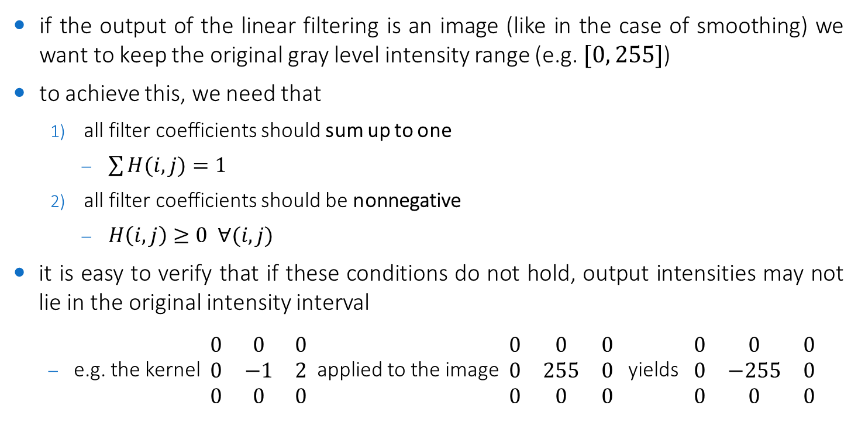
Filter normalization
if the output of the linear filtering is an image (like in the case of smoothing) we want to keep the original gray level intensity range (e.g. $[0, 255]$)
to achieve this, we need that
all filter coefficients should sum up to one
$\sum{H(i,j)}=1$
all filter coefficients should be nonnegative
$H\left(i,j\right)≥0 ∀(i,j)$
it is easy to verify that if these conditions do not hold, output intensities may not lie in the original intensity interval
e.g. the kernel $\begin{matrix}0 & 0 & 0 \\ 0 & −1 & 2 \\ 0 & 0 & 0\end{matrix}$ applied to the image $\begin{matrix}0 & 0 & 0 \\ 0 & 255 & 0 \\ 0 & 0 & 0\end{matrix}$ yields $\begin{matrix}0 & 0 & 0 \\ 0 & −255 & 0 \\ 0 & 0 & 0\end{matrix}$

Slide 11
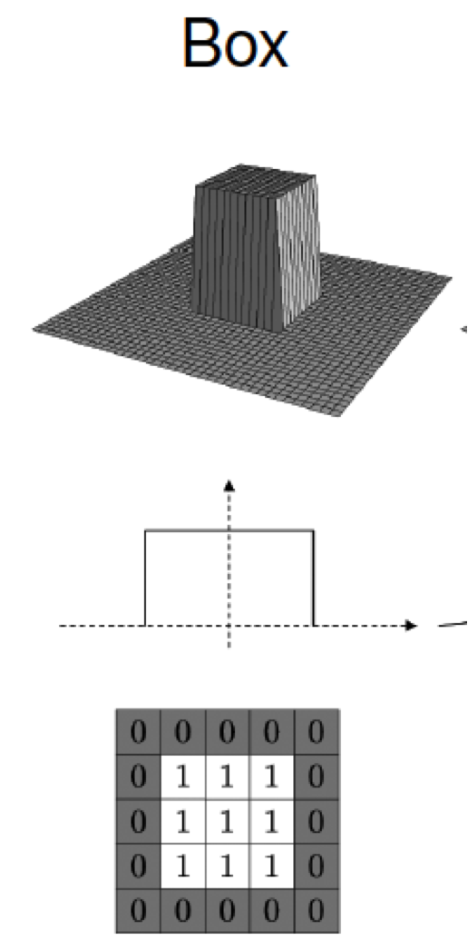
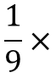
Average filtering
all filter elements are equal
results in defocused images (blur)
also called smoothing or blurring
small details (smaller that the size of the filter) are removed
more attention on large objects
small gaps bridging
noise reduction
edges (=details) are removed
so that filter elements sum up to 1
$$\frac{1}{9}×$$

Slide 12
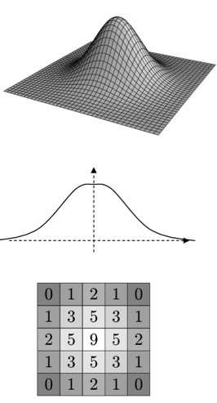
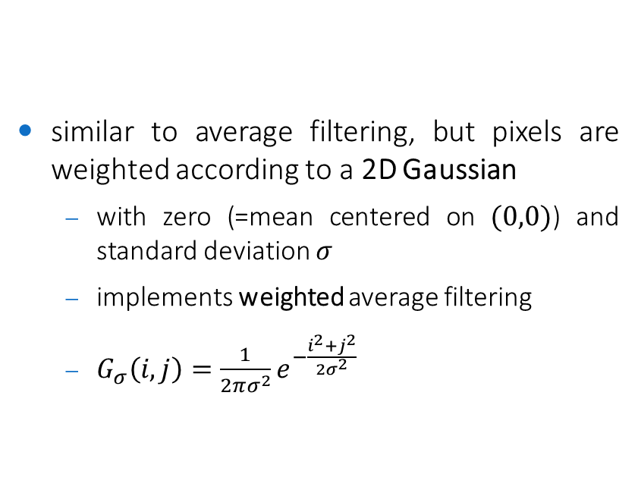
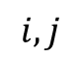
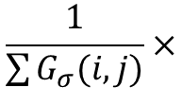
Gaussian filtering
similar to average filtering, but pixels are weighted according to a 2D Gaussian
with zero (=mean centered on $(0,0)$) and standard deviation $σ$
implements weighted average filtering
$G_{σ}\left(i,j\right)=\frac{1}{2πσ^{2}}e^{−\frac{i^{2}+j^{2}}{2σ^{2}}}$
$$i,j$$
so that filter elements sum up to 1
$$\frac{1}{\sum{G_{σ}(i,j)}}×$$

Slide 13
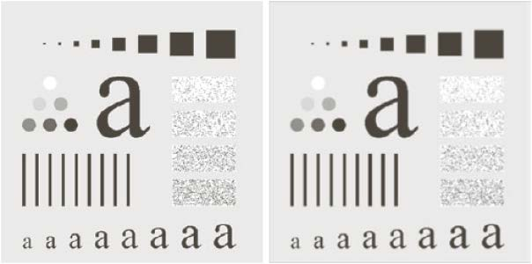
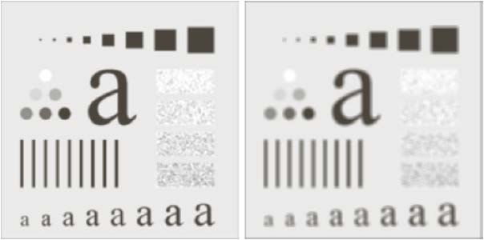
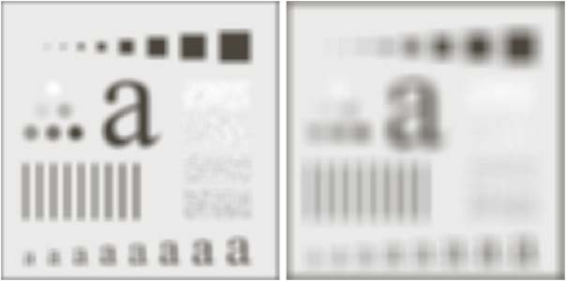
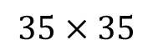
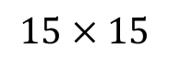
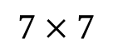
Smoothing: effect of filter size
original
$$7×7$$
$$15×15$$
$$35×35$$

Slide 14
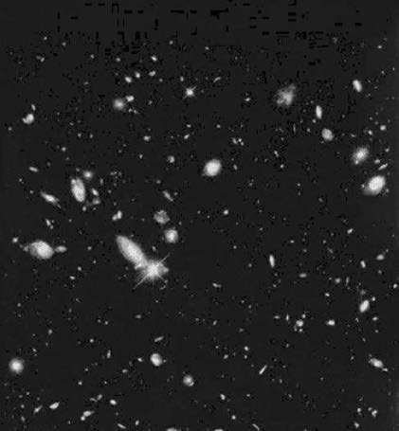

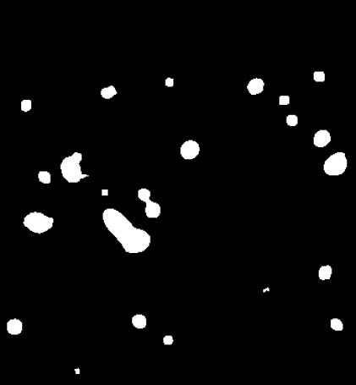
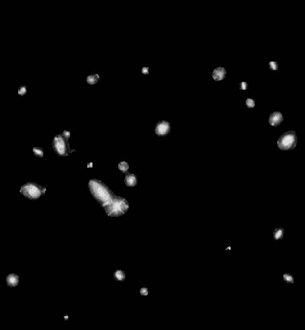
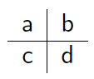
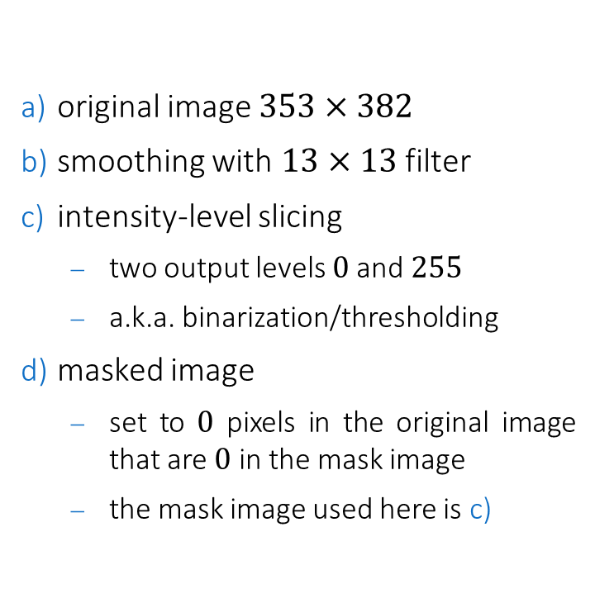
Smoothing: details removal
original image $353×382$
smoothing with $13×13$ filter
intensity-level slicing
two output levels $0$and $255$
a.k.a. binarization/thresholding
masked image
set to $0$ pixels in the original image that are $0$ in the mask image
the mask image used here is c)

Slide 15
Other linear filters
we will see them in a while!
derivative filters
first-order
Sobel
second-order
Laplacian
sharpening filters
with Laplacian
with Gaussian (unsharp masking)

Slide 16
Nonlinear filtering

Slide 17
Nonlinear filters
statistics-based filters are the most used nonlinear filters
ranking (which requires sorting) is more computationally expensive than linear operations
the higher the filter size, the (more than linearly) higher the computational complexity
in particular:
median filter
max and min filters
percentiles based filters
another well-known category of nonlinear filters are morphological filters
we will see them in the next lectures...

Slide 18
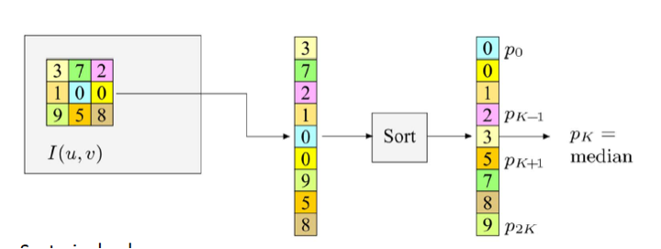
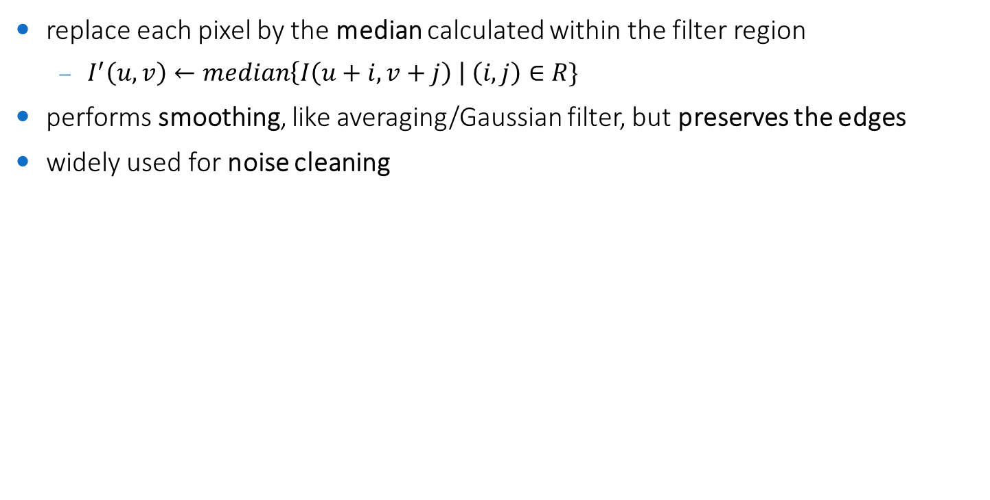
Median filtering
replace each pixel by the median calculated within the filter region
$I^{′}\left(u,v\right)←median\left\{I\left(u+i,v+j\right) \right| \left(i,j\right)∈R\}$
performs smoothing, like averaging/Gaussian filter, but preserves the edges
widely used for noise cleaning

Slide 19
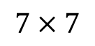
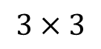
Median filtering: example
original
$$3×3$$
$$7×7$$

Slide 20
Noise reduction (basics)

Slide 21
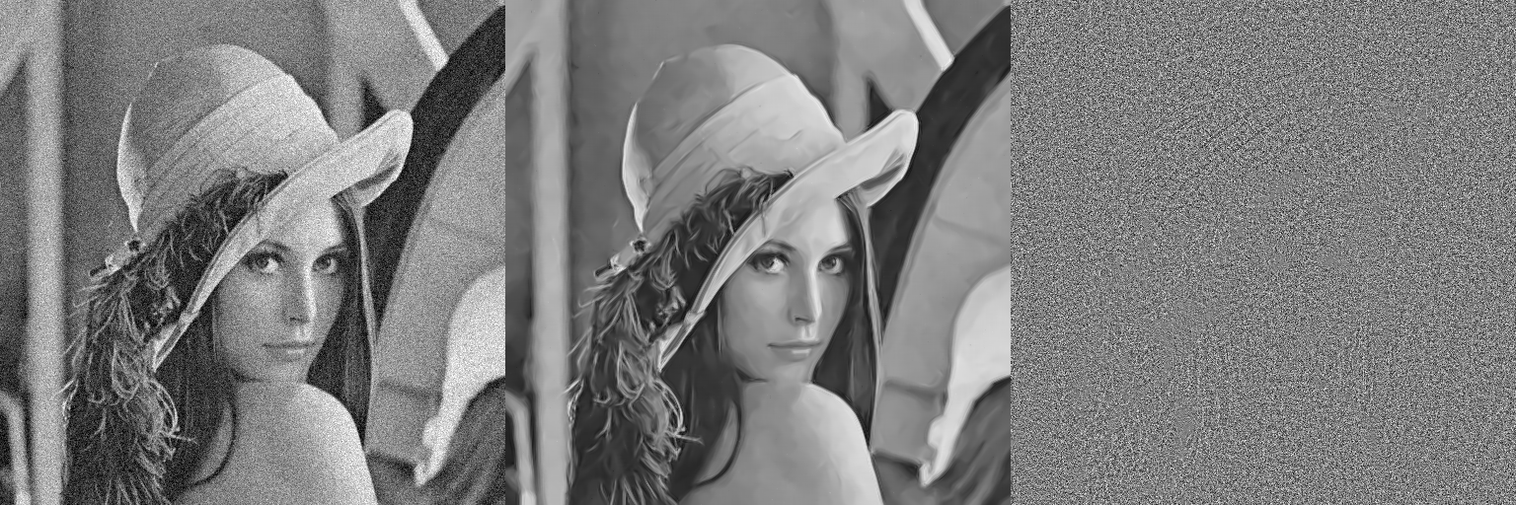
Noise reduction
removing noise is called image restoration
can be done in the spatial domain or in the frequency domain
original
Wiener filtering (in frequency)
difference

Slide 22
Noise types
salt-and-pepper (additive) noise (a.k.a. inpulse noise)
sparsely occurring black and white pixels
caused by external disturbance during telecommunications
gaussian (additive) noise
random valued added to an image
different causes (poor illumination, electronic noise, etc.)
speckle (multiplicative) noise
random valued multiplied by pixel values of an image
mainly due to interferences phenomena
others
periodic noise (e.g. moiré patterns)
shot noise (statistical quantum fluctuations)
quantization noise (image acquisition)

Slide 23
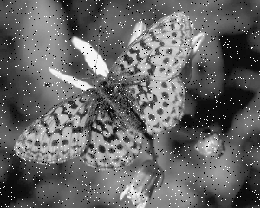
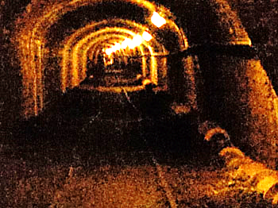
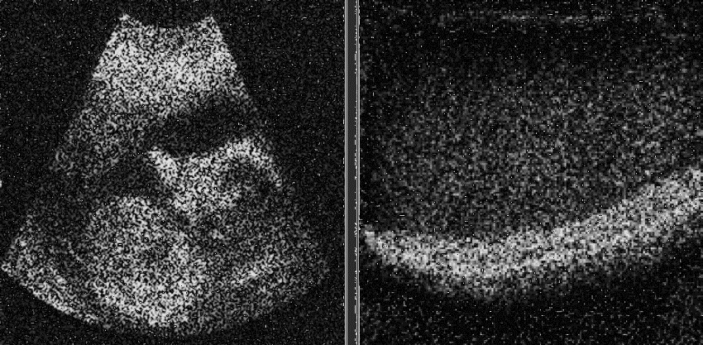
Noise types: examples
salt-and-pepper
gaussian
speckle

Slide 24


Removing salt-and-pepper noise
using averaging/gaussian filters is not a good idea
why?
original
gaussian filtered

Slide 25
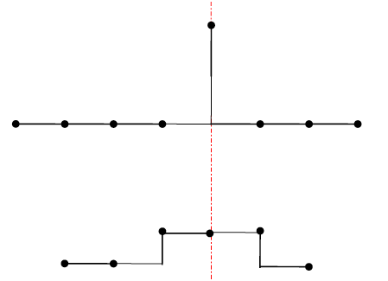
Removing salt-and-pepper noise
using averaging/gaussian filters is not a good idea
why?
original
new values have been created = noise and information have been mixed
gaussian filtered

Slide 26

Removing salt-and-pepper noise
using median filtering is a good idea
why?
original
median filtered

Slide 27
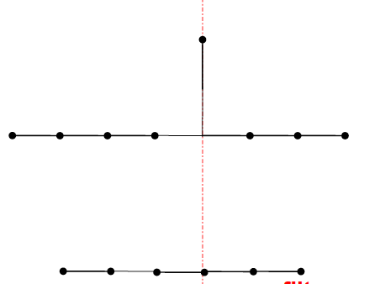
Removing salt-and-pepper noise
using median filtering is a good idea
why?
original
no new values have been created = noise has been removed
median filtered

Slide 28
Exercise
implement in C++/OpenCV linear and nonlinear smoothing filters for denoising a salt-and-pepper corrupted image
design a basic UI with trackbars to set parameters
implement salt-and-pepper noise
solution in /exercises/denoise-salt-and-pepper-ui.cpp

Slide 29

Removing gaussian noise
using either gaussian or median filtering is helpful, but does not work very well
original
gaussian filtered
median filtered

Slide 30
Removing gaussian noise
more complex methods are required
original
bilateral filtering
nonlocal means

Slide 31





Bilateral filtering
non-linear, edge-preserving, and noise-reducing smoothing filter
replaces the intensity of each pixel with a gaussian-weighted average of intensity values from nearby pixels
like the Gaussian filter!
key concept: weights depend not only on spatial distances between pixels, but also on the radiometric (intensity) differences between pixels
$σ_{r}$ defines the extent of the considered intensity range
the larger, the more different intensities will be mixed
$S$ is the search area
influence
$σ_{s}$ defines the spatial extent of the considered neighborhood
the larger, the farther the pixels that will be mixed
$W_{p}$ is the normalization factor

Slide 32

Bilateral filtering: example
original

Slide 33






Nonlocal means filtering
non-linear, edge-preserving, and noise-reducing
replaces the intensity of each pixel with a gaussian-weighted average of intensity values from similar patches that can be found in the image
key concept: weights depend on the similarity between patches, not on their euclidean distance!
$$NLMF{\left[I\right]}_{p}=\frac{1}{W_{p}}\sum_{q∈S}{G_{h}\left({\left\|N_{p}−N_{q}\right\|}^{2}\right)I_{q}}$$
$S$ is the search area, $N_{x}$ the patch centered on pixel $x$
$$N$$
$$S$$
$G$ is a Gaussian-like kernel that depends on the strength parameter $h$ (the higher, the stronger the denoising)
$h \sim σ$ the standard deviation of the noise to be removed

Slide 34


Nonlocal means filtering: example

Slide 35
Exercise
implement in C++/OpenCV the filtering techniques for denoising a gaussian-corrupted image
design a basic UI with trackbars to set parameters
implement gaussian noise using
void cv::randn(cv::Mat dst, cv::Mat mean, cv::Mat stddev)
solution in /exercises/denoise-gaussian-ui.cpp

Slide 36
Image derivatives

Slide 37


Why image derivatives?
the human vision system relies on edges to understand what we see
edge $≝$ sharp change in brightness = discontinuity in the intensity

Slide 38

Why image derivatives?
ideal edge is a step function in some direction

Slide 39

Why image derivatives?
real edges are slightly blurred step functions that can be characterized by their derivatives
specifically, edges have high values of first derivative

Slide 40

Why image derivatives?
first derivative has a peak at the edge
second derivative has a zero crossing at the edge

Slide 41

First derivative
we deal with discrete signals
left and right slope may be different
solution: take average of left and right slopes

Slide 42



First derivative
central difference (average slope)
we can use linear convolution filters
$$Δf\left(x\right)=\frac{1}{2}\left(f\left(x+1\right)−f(x−1)\right)$$
$$H_{x}^{D}=0.5∙\left[\begin{matrix}−1 & 0 & 1\end{matrix}\right]$$

Slide 43





Prewitt and Sobel filters
Prewitt filters (for $x$- and $y$-axis)
combine first-order derivative with slight smoothing (less sensitive to noise)
Sobel filters (for $x$- and $y$-axis)
same as Prewitt, but give more importance to the pixel row/column
they are the most widely used
$$P_{x}=\left[\begin{matrix}−1 & 0 & 1 \\ −1 & 0 & 1 \\ −1 & 0 & 1\end{matrix}\right]$$
$$P_{y}=\left[\begin{matrix}−1 & −1 & −1 \\ 0 & 0 & 0 \\ 1 & 1 & 1\end{matrix}\right]$$
$$S_{x}=\left[\begin{matrix}−1 & 0 & 1 \\ −2 & 0 & 2 \\ −1 & 0 & 1\end{matrix}\right]$$
$$S_{y}=\left[\begin{matrix}−1 & −2 & −1 \\ 0 & 0 & 0 \\ 1 & 2 & 1\end{matrix}\right]$$

Slide 44




First derivative: example
original ($I$)
$$I_{x}=I∗S_{x}$$
$$I_{y}=I∗S_{y}$$

Slide 45



Gradient
the gradient of a function (image) is the vector formed by its partial derivatives
points toward the direction of maximum variation and has magnitude proportional to the rate of variation
$$∇I\left(x,y\right)=grad\left(I\right)={\left[\begin{matrix}\frac{∂I(x,y)}{∂x} & \frac{∂I(x,y)}{∂y}\end{matrix}\right]}^{T}={\left[\begin{matrix}I_{x} & I_{y}\end{matrix}\right]}^{T}$$
$$M\left(x,y\right)=mag\left(∇I\left(x,y\right)\right)=\sqrt{I_{x}^{2}+I_{y}^{2}}$$
$$Φ\left(x,y\right)=phase\left(∇I\left(x,y\right)\right)=atan2\left(I_{y},I_{x}\right)$$

Slide 46



Gradient image
the magnitude of the gradient of an image, normalized in the representation interval $[0,L−1]$
$M\left(x,y\right)=\sqrt{I_{x}^{2}+I_{y}^{2}}≈\left|I_{x}\right|+|I_{y}|$

Slide 47


Gradient image: example
original ($I$)
$$M(I)$$

Slide 48

Exercise
create a function that takes a cv::Mat in input (either color or grayscale) and returns a grayscale cv::Mat gradient image
cv::Mat gradientImage(const cv::Mat & img)
optionally, you may try this in combination with your laptop camera for real-time video processing by calling:
aia::processVideoStream("", gradientImage);
solution in /exercises/gradient-image.cpp

Slide 49




Second derivatives
a good approximation of the second derivative of a discrete function is:
which has the following properties
is $=0$ where the intensity is constant
is $≠0$at the beginning of a step (or a ramp) of the intensity
is $=0$ on the constant slope (=first derivative) ramps
in the case of images, it can be implemented with linear convolution kernels
$$\frac{∂^{2}f}{∂x^{2}}=f\left(x−1\right)−2f\left(x\right)+f(x+1)$$
$$DD_{x}=\left[\begin{matrix}0 & 0 & 0 \\ 1 & −2 & 1 \\ 0 & 0 & 0\end{matrix}\right]$$
$$DD_{y}=\left[\begin{matrix}0 & 1 & 0 \\ 0 & −2 & 0 \\ 0 & 1 & 0\end{matrix}\right]$$

Slide 50



Second derivatives: example
original ($I$)
$$I_{xx}=I∗{DD}_{x}$$
$$I_{yy}=I∗{DD}_{y}$$

Slide 51



Laplacian
usually second-order derivatives are combined into one single isotropic operator
isotropic = rotation invariant, e.g. we would like second-order derivatives not to depend on edge orientation, which is well captured by the gradient vector
the Laplacian is the simplest isotropic derivative operator
which translated into linear convolutional kernel becomes:
$$∇^{2}f\left(x,y\right)=\frac{∂^{2}f(x,y)}{∂x^{2}}+\frac{∂^{2}f(x,y)}{∂y^{2}}$$
$$L_{90°}=\left[\begin{matrix}0 & 1 & 0 \\ 1 & −4 & 1 \\ 0 & 1 & 0\end{matrix}\right]$$
$$L_{45°}=\left[\begin{matrix}1 & 1 & 1 \\ 1 & −8 & 1 \\ 1 & 1 & 1\end{matrix}\right]$$
Laplacian filter invariant to 90° rotations
Laplacian filter invariant to 45° rotations

Slide 52


Laplacian: example
the Laplacian of an image has often negative values
in order to be visualized, it must be properly normalized to $[0,L−1]$
original
laplacian (unscaled)
laplacian (scaled)

Slide 53
Laplacian: example
the Laplacian of an image has often negative values
in order to be visualized, it must be properly normalized to $[0,L−1]$
original
laplacian (scaled)

Slide 54

Sharpening

Slide 55




Sharpening with Laplacian filtering
idea: subtract second derivative from the image so that the slope of edge ramps are exaggerated
where $k$ is the strength of the sharpening
the higher, the sharpener
by applying the properties of convolution and $L_{45°}$, we get the following sharpening filter:
$$sharp\left(I\right)=I−k∙∇^{2}I$$
$$S_{L}=\left[\begin{matrix}−k & −k & −k \\ −k & 1+8k & −k \\ −k & −k & −k\end{matrix}\right]$$

Slide 56


Sharpening with Gaussian filtering (Unsharp masking)
the most widely used sharpening technique:
smooth the original image (e.g. with Gaussian filtering)
obtain the mask as the difference between the original image and its smoothed copy
in terms of 'frequency', we are isolating the higher frequency components
add the mask to the original image
in terms of 'frequency', we are enhancing the higher frequency components (=sharpening)
where $k$ is the strength of the sharpening
the higher, the sharpener
$$unsharp masking\left(I\right)=I+k(I−I∗G_{σ})$$

Slide 57


Exercise
create a simple UI to interactively sharpen the input image
1 trackbar with sharpening factor
real-time update of the sharpened image
solution in /exercises/sharpen-ui.cpp

